Slide 1
CoffeeScript is For Closers
Brandon Satrom
@BrandonSatrom
UserInExperience.com

Slide 2
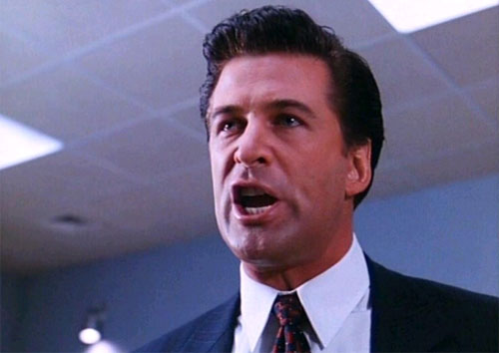
Put the Coffee(Script) Down! Coffee(Script) is for Closers!
Notes:
The title of this presentation is not a closure joke. It’s a reference to a quote from Alec Baldwin in the movie Glengarry Glenn Ross. And in spite of it’s kitschy nature, it does have a meaning in this presentation. But I’m getting a little bit ahead of myself. As this presentation has more faces than Eve, we should talk a bit about alternate titles…

Slide 3
Or…
JavaScript, Linguistics and Cockney Rhyming Slang
Notes:
I love Kurt Vonnegut, and if you’re familiar with his work, he loved to give his books alternate titles. For example, Slaughterhouse Five has the alternate title “The Children’s Crusade: A Duty-Dance with Death.” Breakfast of Champions has the alternate title “Goodbye Blue Monday.” In fact, Vonnegut had a tendency to choose catchy titles, while creating secondary titles that more aptly described the book. In that vein, this presentation is also titled “JavaScript, Linguistics and Cockney Rhyming Slang.
Not to be outdone by Mr. Vonnegut, I have yet another title for this presentaiton

Slide 4
Or…
How CoffeeScript Made me a Better JavaScript Developer
Notes:
More accurately of all, How CoffeeScript Made me a Better JavaScript Developer

Slide 5
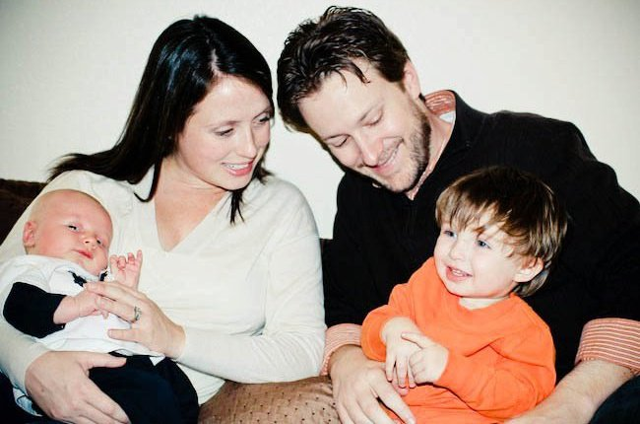
So Who Am I?
Husband and Father
Web Developer & Evangelist, Microsoft
Austin, TX
www.userinexperience.com
@BrandonSatrom
github.com/bsatrom
Notes:
So who am I, anyway?

Slide 6
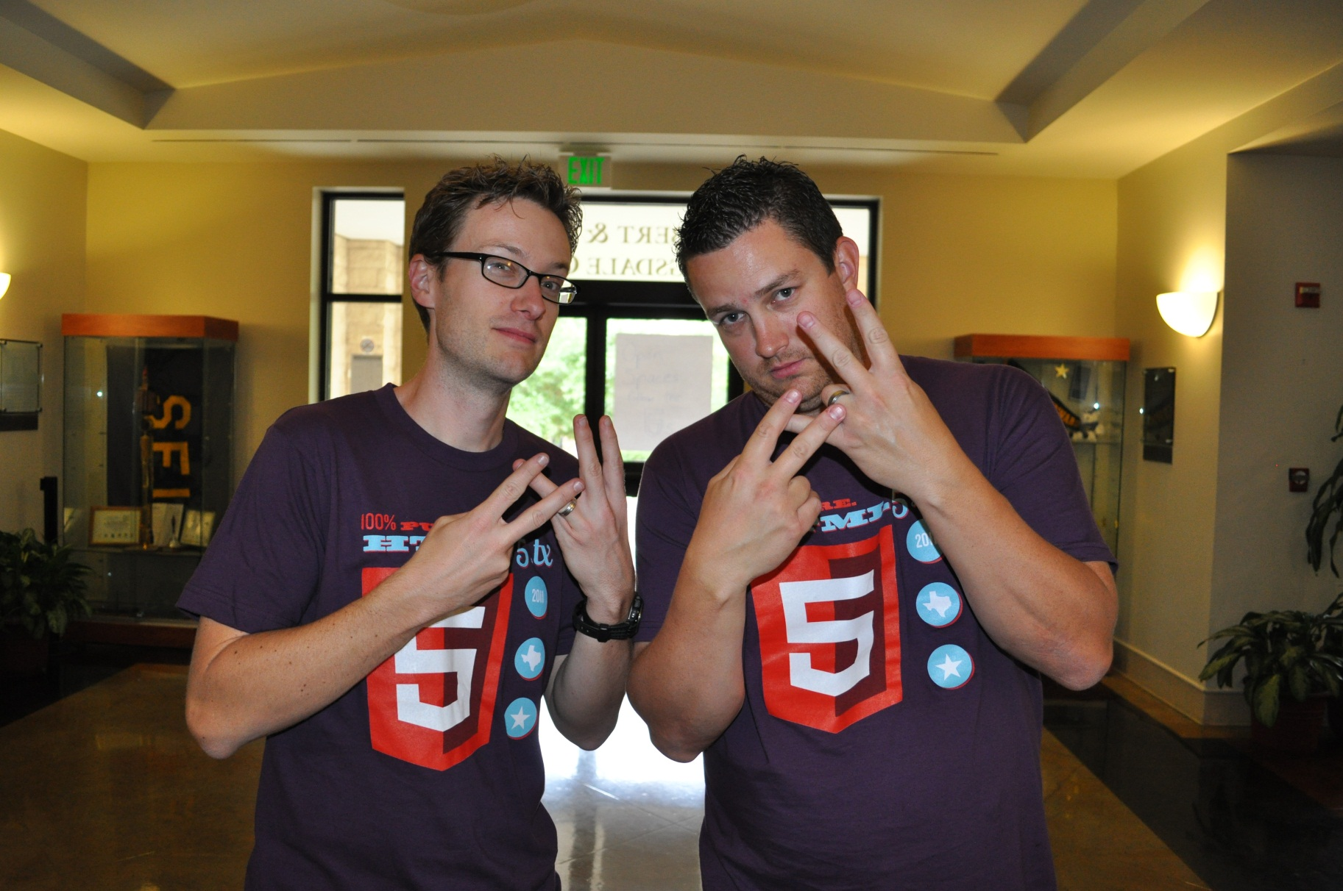
#html5tx
Notes:
I’m also one of the founder of HTML5.tx, an all-things open web conference in Austin, TX.

Slide 7
Agenda
The JavaScript Dialectic
What?
Why?
Where?
How?
Again, with the Dialectic
Ball and Chalk
Notes:
Ball and Chalk is cockney rhyming slang for Walk, meaning that we’ll take a break after this session.

Slide 8
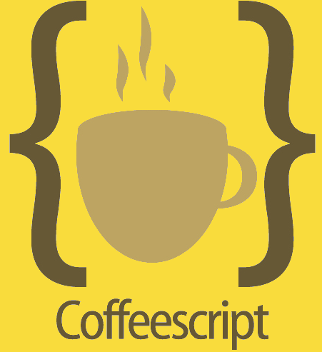

VS.
Notes:
I expect that there are three types of people here today when it comes to JavaScript. You’re either:
A die hard CoffeeScript Fan
Skeptical of CoffeeScript
Don’t have enough information to decide yet
A significant portion of my talk today is about the What and Why of CoffeeScript, for a couple of reasons:
You’re not going to remember all of the syntax I show you
There’s not a lot of coherent discussion online about if and why CoffeeScript matters, just some assumptions that everyone should or should not use it
I have an opinion about why CoffeeScript matters, even if you never choose to use while building a production app, but I am open minded about it’s place. It’s also not something I use exclusively for my development. I still use JavaScript a majority of the time.

Slide 9
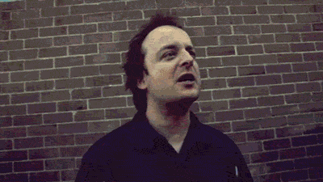
A JavaScript Dialectic
Notes:
A Dialectic is a method for resolving disagreement, around in both Western and Eastern philosophy for thousands of years.
“Dialogue between two or more people holding different points of view about a subject, who wish to establish truth of the matter by dialogue, with reasoned arguments.”
- This is different than debate, where each party is committed to their points of view and mean to win the debate.
- Also different than rhetoric, which appeals to emotion rather than logic and reason.

Slide 10


Don’t Be A JavaScriptster
I loved JavaScript before it was cool
Of course, I also hated it back when everyone else did too…
Notes:
If you are skeptical, though, I only ask that you not be a JavaScripster. Be willing to consider the place that CoffeeScript might have in your own development, and do try it for yourself.
The point of a dialectic, at least as I understand it, is to bring people with opinions together. As long as the people are more interested in knowledge and progress than “winning the argument,” there is potential for everyone to learn and to grow in their thinking. I may represent one viewpoint, but I am open to having my own mind changed by you all. I hope, in the course of this conversation, that we can all leave with different perspectives on CoffeeScript, but also JavaScript in general.

Slide 11
What?
What is CoffeeScript?

Slide 12
Why?
Why should I bother using it?

Slide 13
Where?
Where do I get it?

Slide 14
How?
How can I use, learn and automate it?

Slide 15
Again, with the Dialectic…
What Can I/We/Everyone Learn from CoffeeScript?

Slide 16
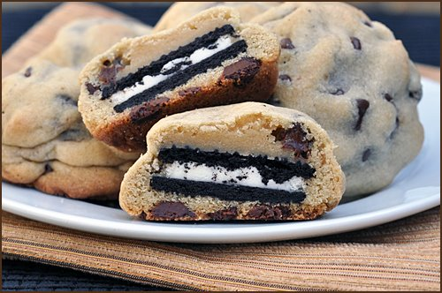
This… Changes… Everything!
Notes:
Go create your own language!
Things like this have a way of moving the web forward
We can’t rely on just “design by committee”
Whomever ships, wins!

Slide 17
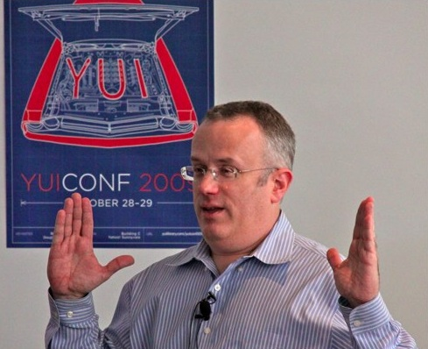
This is not about Replacing JavaScript!
"We are not just advocating a language on top of JS that you use to avoid JS (GWT, Haxe, Objective-J, etc.). We are advocating that you all help build a better JS on JS, which then becomes standardized as JS.next." - Brendan Eich
Notes:
According to Brendan Eich, this is about bringing JavaScript full circle, not about replacing, but enhancing JavaScript. We shouldn’t see CoffeeScript as a threat to JavaScript because it wasn’t born in the same spirit as languages like GWT and Dart, where staying as far away from JS is the goal.
"We are not just advocating a language on top of JS that you use to avoid JS (GWT, Haxe, Objective-J, etc.). We are advocating that you all help build a better JS on JS, which then becomes standardized as JS.next." - Brendan Eich (re: his talk with Jeremy at JSConf.EU)

Slide 18
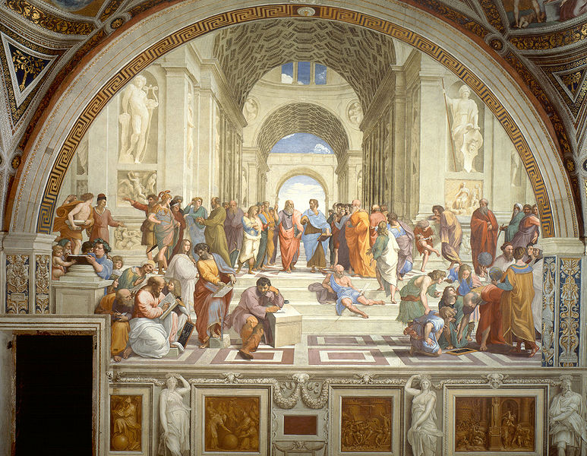
In the Spirit of the Dialectic…
Notes:
SO… In the spirit of the dialectic, here’s my proposal: “JavaScript is a beautiful language, but it has its snares and pitfalls. What’s more, it is constrained severely by backwards compatibility and committee-driven design. CoffeeScript IS JavaScript, but a dialect that experiments with what JavaScript could be were it unencumbered, all the while staying faithful to the language. I believe that, as a community, we should embrace CoffeeScript because it represents a movement, not to replace JavaScript, but evolve and improve upon it. Embracing might mean using the language and becoming a better JavaScript developer as a result. Or it might mean using it, and seeing a vision of how JavaScript can be improved. You don’t have to “adopt” it if you don’t want to, but you should be aware of it.”

Slide 19
Ball and Chalk

Slide 20
Resources - http://bit.ly/...
CoffeeScript Website - nfWYwn
Annotated Source - qdAXfn
CoffeeScript Koans -
Smooth CoffeeScript Book
Jeremy and Brendan @ JSConf 2011
“Harmony of my Dreams”
Notes:
CoffeeScript Website - http://jashkenas.github.com/coffee-script/
CoffeeScript Annotated Source - http://jashkenas.github.com/coffee-script/documentation/docs/grammar.html
CoffeeScript Koans -
Smooth CoffeeScript Book -
Jeremy and Brendan @ JSConf 2011 -
Bendan’s “Harmony of My Dreams” Post -

Slide 21
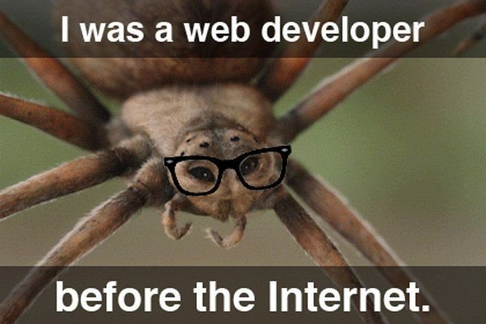
Questions?
@BrandonSatrom
brsatrom@microsoft.com
UserInExperience.com

Slide 22
[APPENDIX]

Slide 23
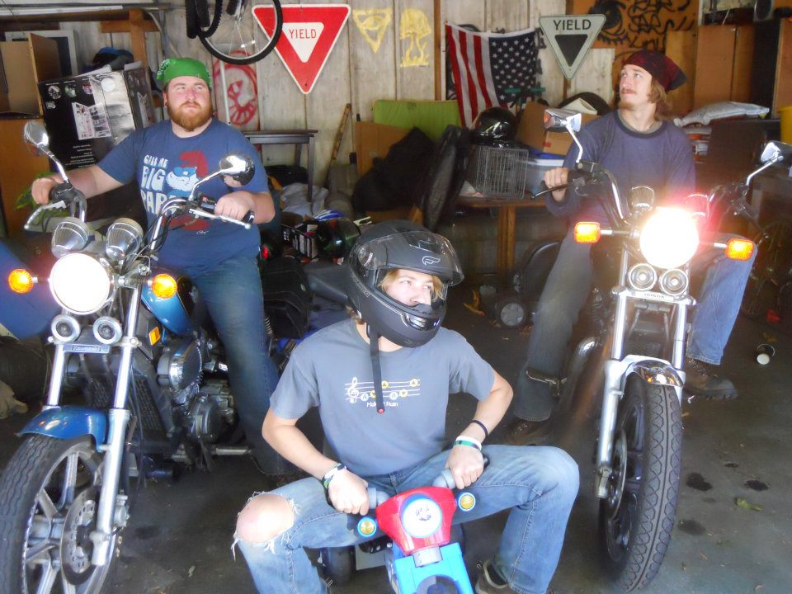
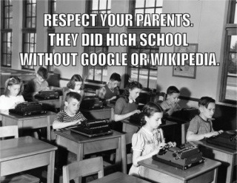
What some programmers think of JavaScript…

Slide 24
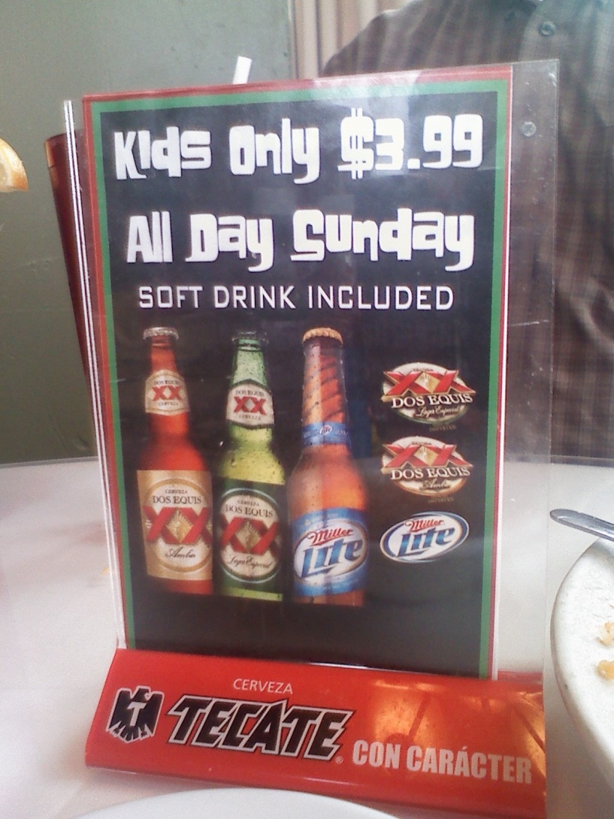
Use When Appropriate…

Slide 25
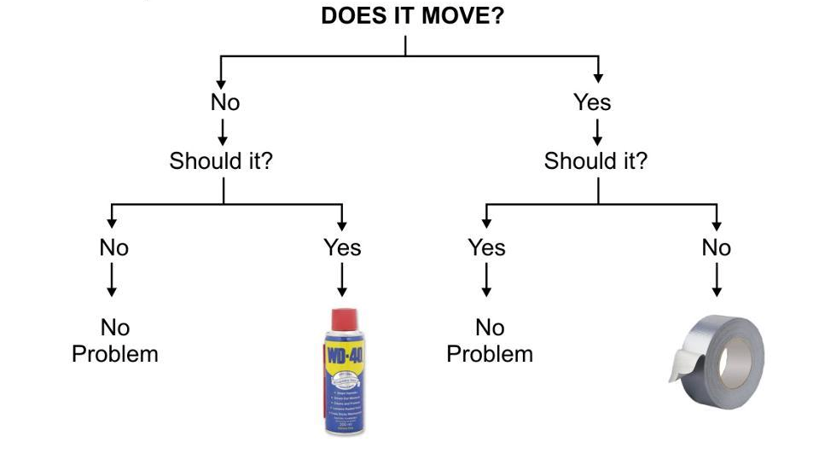
Pick the Right Tool for the Job

